Slide 1
Elmer FEM – Dakota interface
Anjali Sandip, Ph.D.
Senior Lecturer
Department of Mechanical Engineering
University of North Dakota
Notes:
1

Slide 2
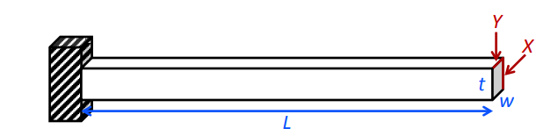
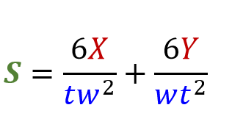
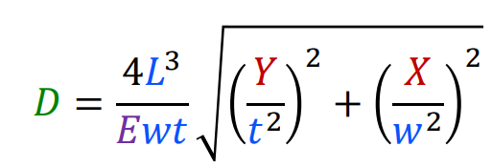
Cantilever beam - numerical model ^{1,2}
Parameters:
L: length (m)
W: width (m)
T: thickness (m)
ρ: density (kg/m³)
E: Young’s modulus (N/m²)
X: horizontal load (N)
Y: vertical load (N)
Responses:
M: mass (kg)
S: stress (Pa)
D: displacement (m)
M = ρ × w ×t ×L
[1]. Bayoumi, S. (2018). Engineering solid mechanics: fundamentals and applications. Routledge.
[2]. Sandia Dakota (2015). Sandia Dakota training materials. Retrieved from https://dakota.sandia.gov/training/dakota-training-materials

Slide 3
Cantilever beam – Finite element (FE) model in Elmer
PRE-PROCESSING
External package
Build 3D CAD + mesh
Module ⁴
Geometry | Rectangular block (L × w × t)
Mesh | Mesh element type – quadratic hexahedral elements Mesh size – 6073 nodes, 1200 elements
Simulation setup | Steady-state 3-dimensional Cartesian coordinates
Equation | Linear elasticity theory
Material | Steel ³ Density = 8000 kg/m³ Young’s modulus = 2.0e11 Pa
Loads and boundary conditions | Loads – pressure distributed uniformly over the cross-sectional area on the free end in the X and Y directions Boundary conditions – same as numerical model
Elmer GUI
Build FE model
RUN
Elmer Solver
Build FEM solution
POST-PROCESSING
ParaView
View results
[3]. MatWeb (1996 – 2019). Steel, General Properties. Retrieved from http://www.matweb.com/search/datasheet.aspx?bassnum=MS0001&ckck=1

Slide 4
Dakota input file
#Latin hypercube sampling (LHS)/Cantilever beam
variables
#uncertain variables follow normal distribution
normal_uncertain 3
#uncertain variables – length (m), width (m), thickness (m)
descriptors 'L' 'w' 't'
means 0.127 0.05 0.05
std_deviations 0.0127 0.005 0.005
#fixed parameters – Young’s modulus (Pa), density (kg/m3), horizontal load (N), vertical load (N)
continuous_state 4
descriptors 'E' 'p' 'X' 'Y'
initial_state 2.0e11 8000 1560 2225
responses
# simulation output – mass (kg), displacement (m), stress (Pa)
response_functions 3
descriptors 'mass' 'displacement' 'stress'
no_gradients
no_hessians

Slide 5
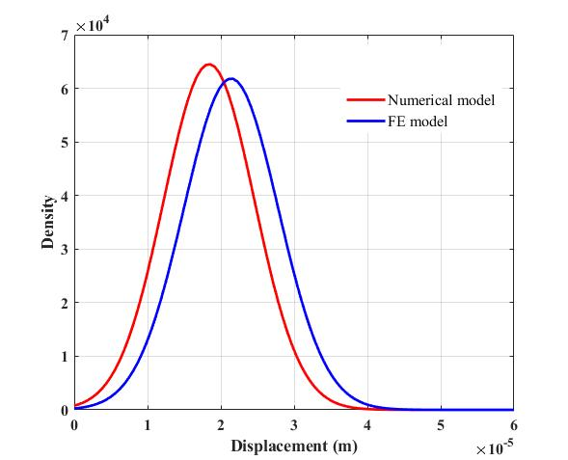
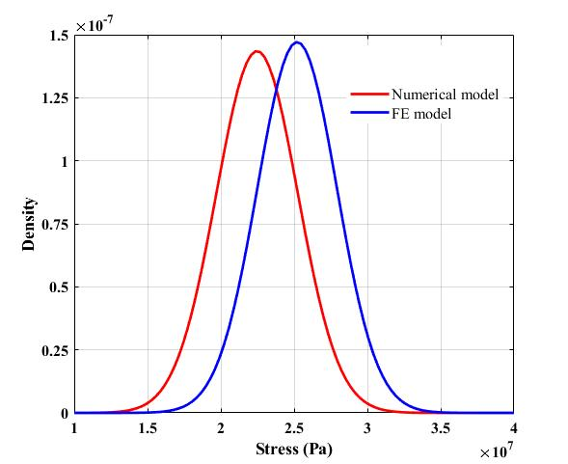
Results
 | Numerical model | FE model
Mass (kg) | 2.54 + 0.44 | 2.54 + 0.44
Displacement (m) | 1.84e-05 + 0.61 | 2.13e-05 + 0.65
Stress (Pa) | 2.24e+07 + 0.27 | 2.52e+07 + 0.27
Probability density functions (pdf) - displacement and stress

Slide 6
Results
Fraction of samples that violate the displacement and stress constraints
 | Numerical model | FE model
displacement | 13.5% | 25.5%
stress | 0% | 0%

